Slide 1
Compiler verification with hardware and software simulation
Hugh Considine
University of South Australia
Notes:
Read from slide

Slide 2
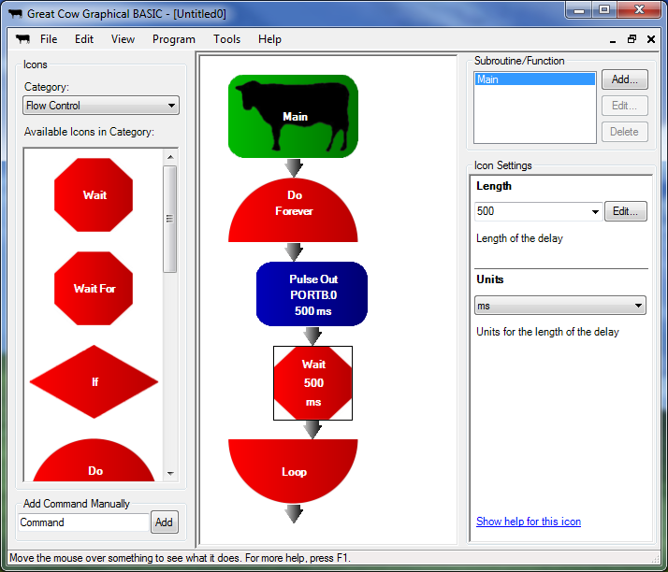
Notes:
Three programs I’ve written:
Great Cow Graphical BASIC, which lets users edit microcontroller programs with icons.
Icon programs are turned into text code, which can be edited as well.
This allows inexperienced users to start with the graphical interface and gradually proceed to text as they become comfortable.

Slide 3
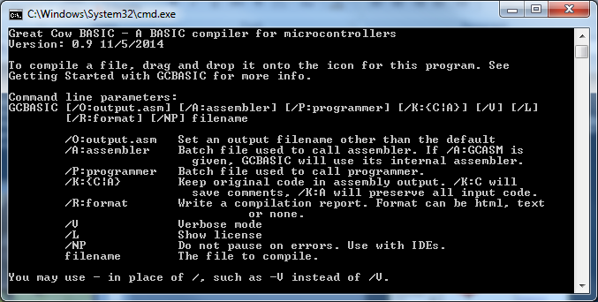
Notes:
Great Cow BASIC, a command line compiler which takes text programs or programs from GCGB or other editors, and turns them into machine code for 8 bit PIC and AVR microcontrollers

Slide 4
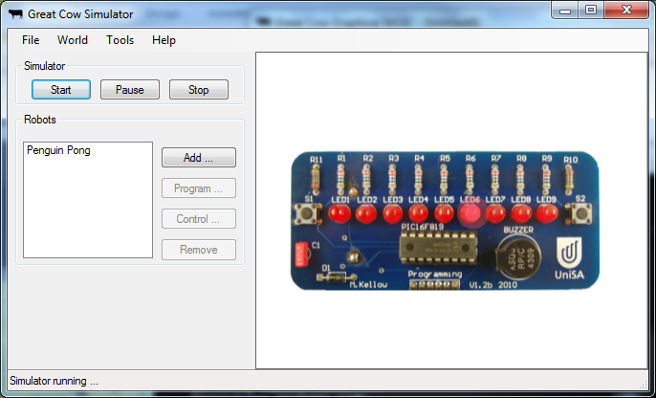
Notes:
Great Cow Simulator, a work in progress that simulates robots and microcontroller based circuits on the PC.
These are all programs that I’ve been developing since December 2005 – initially as solo projects, but now with the assistance of a growing team online.
But, it’s just a couple of free programs. Who cares if they work?

Slide 5
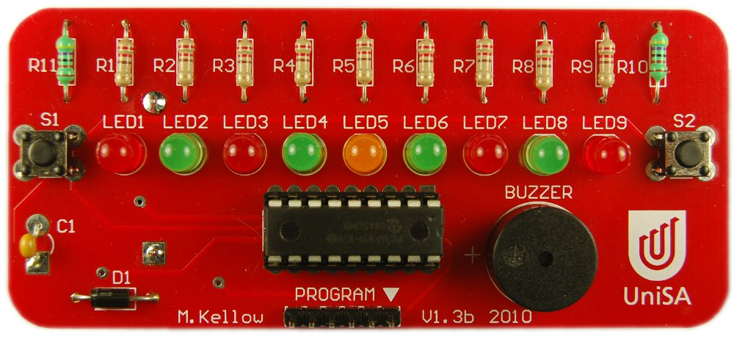
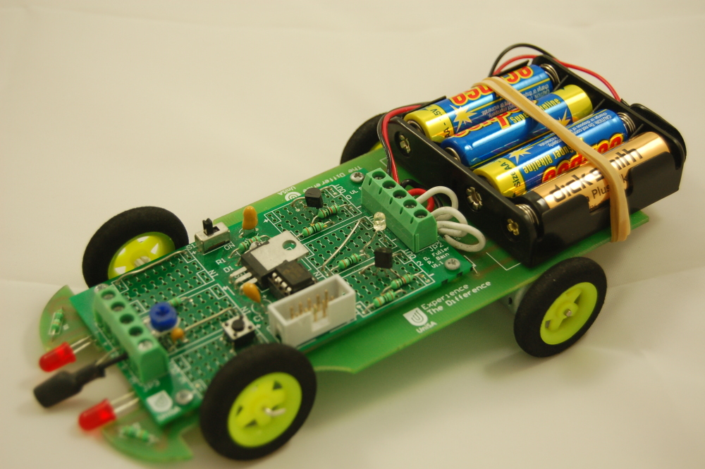
Notes:
Great Cow has been used in many places.
It was used to program the University’s Penguin Pong kit – over 5000 of these have now been given away. Back in 2010, some primary school students used Great Cow to write their own programs for these.
It’s also been used in a programming course with the Envirocar robot – students used Great Cow to program these to follow lines and jump out of cupboards.

Slide 6
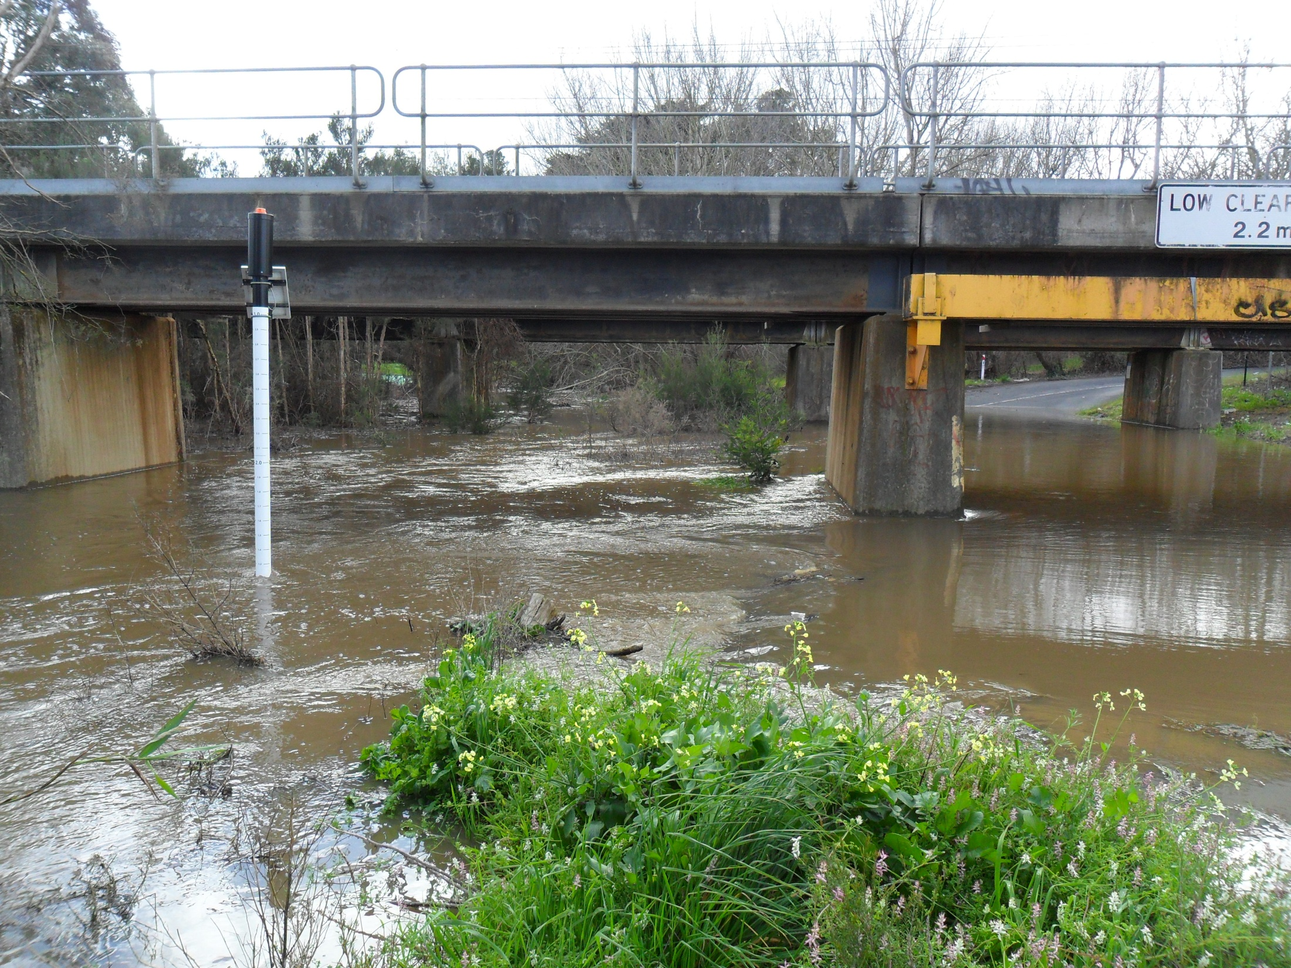
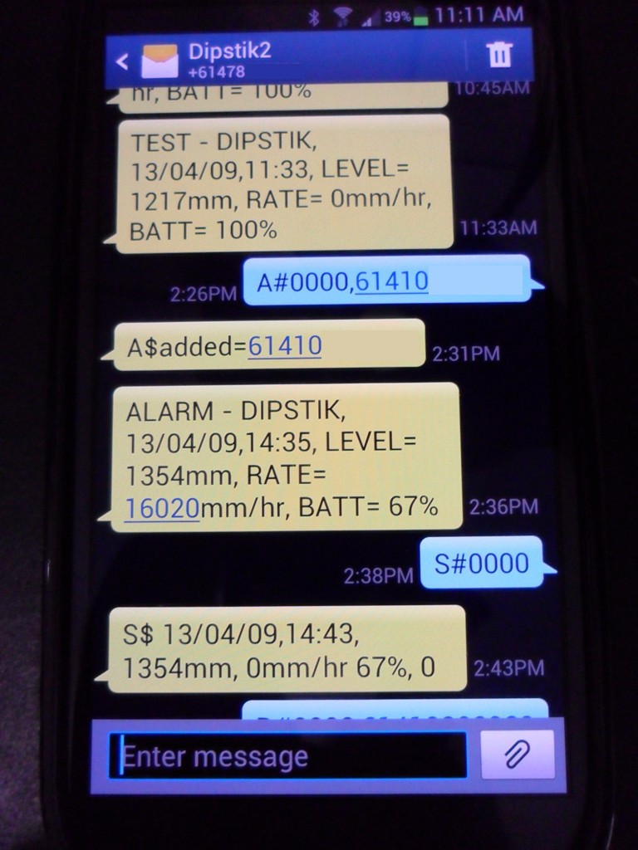
Tuftec Solutions
Notes:
Great Cow has been used in some useful products, including a few developed by Tuftec Solutions, a Melbourne company. This particular product is the DipStik, which detects flooding.
Here, a low lying road passes under a railway bridge next to a creek. The creek often floods after heavy rain, blocking the road.
When the DipStik detects a flood, it warns the local council via text message, and they close the road.
Now, this is a situation where an error in Great Cow could lead to a dangerous situation for anyone. What if a bug stopped the message sending from working intermittently, the council wasn’t notified, and a driver drove into the flood and wrote off their car or worse?

Slide 7
Compiler Correctness
Unit Testing
Notes:
In computer science, there is a field of research devoted to testing compilers and ensuring that they work correctly, called compiler correctness. This means making sure that the translated code that comes out does the same thing as the code that goes in. But this is largely a theoretical area, and is often based on extremely simple compilers. It also does not ensure that libraries of code included with the compiler are functioning correctly.
So, this project instead uses the idea of unit testing. In unit testing, a piece of software is divided into units, and each unit is tested individually.
For my final year project in 2014, I have applied unit testing concepts to the compiler.

Slide 8
1. Static Analysis
Notes:
More specifically, the project focuses on 3 approaches:
The first is static analysis, in which computer programs analyse the compiler’s output for errors.

Slide 9
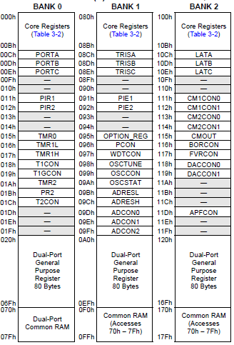
banksel ADCON0
bsf ADCON0, ADON
banksel DACCON1
clrf DACCON1
banksel ADCON0
bsf ADCON0, ADON
clrf DACCON1
Notes:
One static analysis tool has already been created. It deals with some bank selection problems.
On a PIC, memory is divided into banks. Before a variable can be accessed, the correct bank must be selected. If it isn’t, the wrong memory location will be read or written to. But bank selection commands must be added only where needed, or the program will become too big. The compiler is meant to do this automatically, but in some cases wasn’t.
In this example, the code needs to set two registers, ADCON0 and DACCON1.
But if the second banksel is left out, then it will instead set ADCON0 and OSCCON, and instead of changing the DAC output level, it will switch the PIC to run at 4 times the expected clock speed. Very confusing for the user!

Slide 10
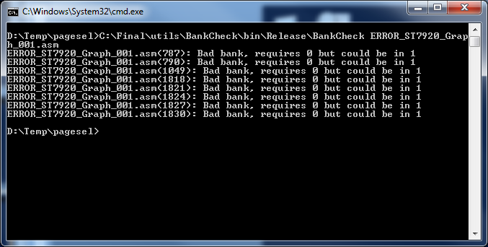
Select 1
Access 1
If
Select 2
Access 1
Access 2
!?!?
Access 1
Notes:
Sometimes, there is a banksel but it isn’t in the right place.
To detect this, a program was created to determine where the commands were missing. It builds a control flow graph for the program, showing which order commands can run in. From this, it knows where banksel commands are needed.
If the compiler has left out a bank selection instruction somewhere, an error is generated. Here, it has found 7 errors in 2000+ lines of assembly produced by Great Cow BASIC – which would have been fun to do manually!
Before this tool, page and bank selection errors were being found every few months. When this tool was first implemented, 3 different ones were found and fixed. In the year since, this tool helped to discover one more bank selection issue far more quickly than it would have been otherwise.

Slide 11
2. Software Simulation
Notes:
Software simulation. In this approach, a known good program is compiled and run in a software simulator. If it doesn’t work, then it wasn’t compiled properly.

Slide 12
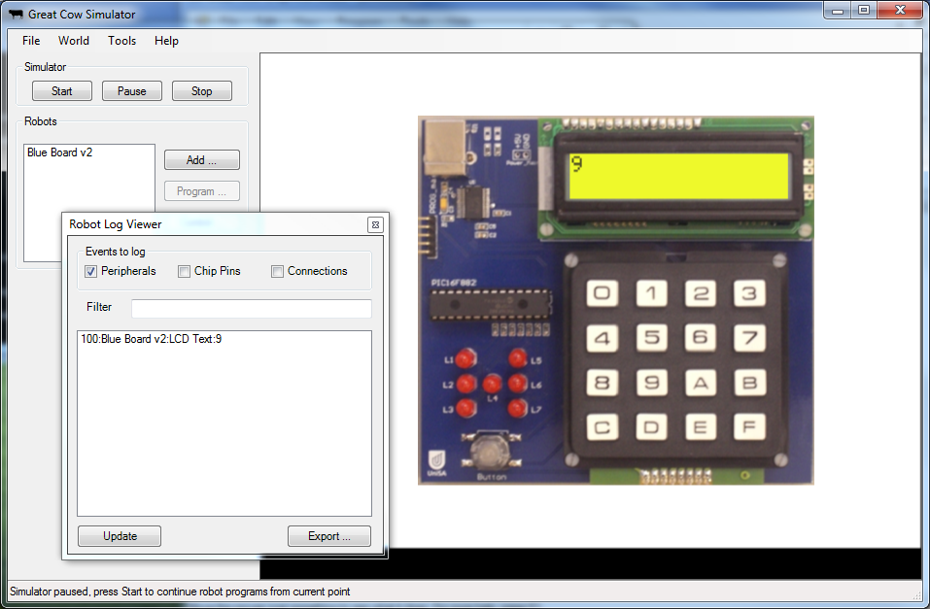
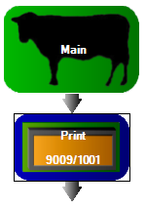
Notes:
As mentioned before, for software emulation, we take a known good BASIC program. On the left, we have a known good program that should display 9 on the LCD.
This is put through the compiler under test, and then run in a software simulator.
When compiled and run in the simulator, the log viewer shows that the LCD text changes to 9 at time 100 ms. This means all is well! The test log is then saved by the simulator, and an external program analyses it and compares it to the expected results.

Slide 13
3. Hardware Simulation
Notes:
Hardware simulation. As with software simulation, a known good program is compiled. Then, it is sent to a hardware device that will run it, and the computer will verify that it has run properly.

Slide 14


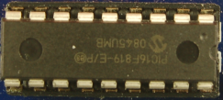
Control Microcontroller
Test Microcontrollers
Notes:
Hardware simulation is based on a similar idea. But instead of using the PC simulator to run the machine code under test, it is sent to an appropriate test microcontroller.
We also need some way to interact with the test programs and capture their output, so there is a control microcontroller responsible for this.
In most cases the software simulator provides good testing, but the hardware simulator will help to find any bugs unique to a particular chip model that haven’t been programmed in to the software simulator.

Slide 15
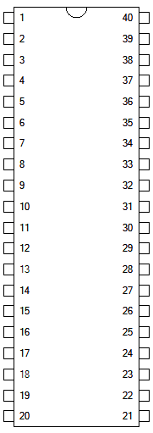
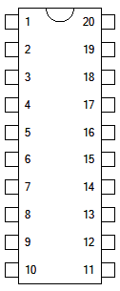
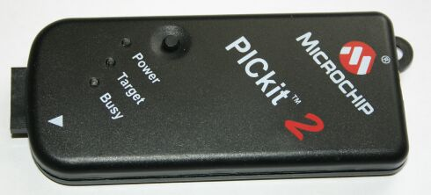
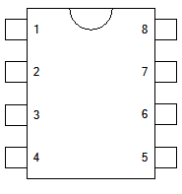
USB
Control Microcontroller
PIC 18F4550
USB
Test bus
(ADC, digital, serial)
ICSP/ISP
Test Microcontrollers
(4 PIC, 2 AVR)
Notes:
There are several key components in the hardware simulator.
First, we have the PC controlling it. This connects through USB to the control microcontroller.
The control microcontroller is connected to the test microcontrollers through a test bus.
The test bus has connections for an analogue signal, for several digital signals, and for several specific serial protocols (I2C and RS232).
And finally, a PICkit 2 programmer is present. This connects to the test microcontrollers through a multiplexor circuit, so that the control microcontroller can select one particular test microcontroller to receive the downloaded program.

Slide 16
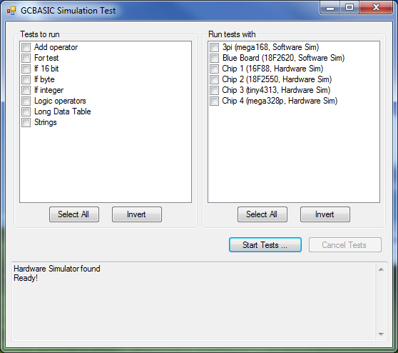
Notes:
The software and hardware simulator can be controlled by a single piece of software.
The software presents a list of unit tests, and a list of targets that can be used to run these tests.
The output of the tests is captured and displayed in the log area, and any issues are highlighted.

Slide 17

Notes:
This final year project has resulted in less bugs. The static analysis code in particular has fixed a long standing issue, and the software/hardware simulation will become more effective as more test cases are prepared.
And a small side effect has been some extra reusable code that can be made available to GCBASIC users. The USB interface code for the hardware simulator, for example, is written in Great Cow and will allow users of Great Cow to develop their own USB products.

Slide 18
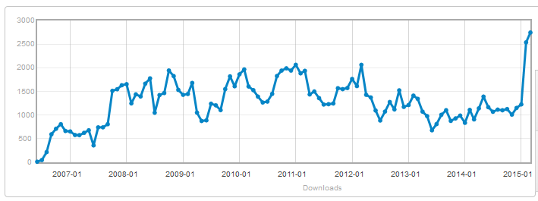
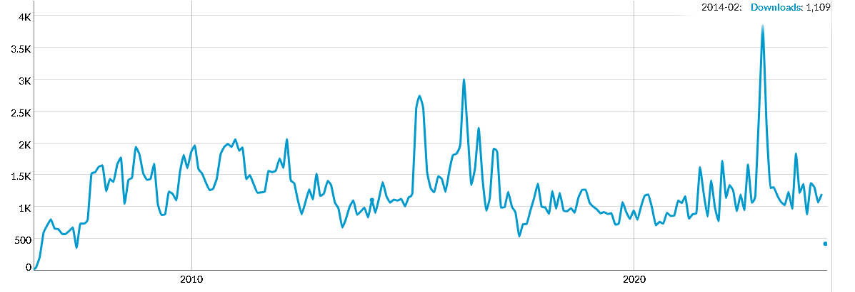
http://sourceforge.net/projects/gcbasic/files/stats/timeline?dates=2006-06-12+to+2015-03-31
Notes:
Here’s a download graph for the entire history of the Great Cow project.
In March 2015, we put out new release, with the improved compiler and many extra useful libraries by other developers. It has attracted some attention! Of these 134,000 total downloads, almost 40,000 are of the graphical BASIC.

Slide 19
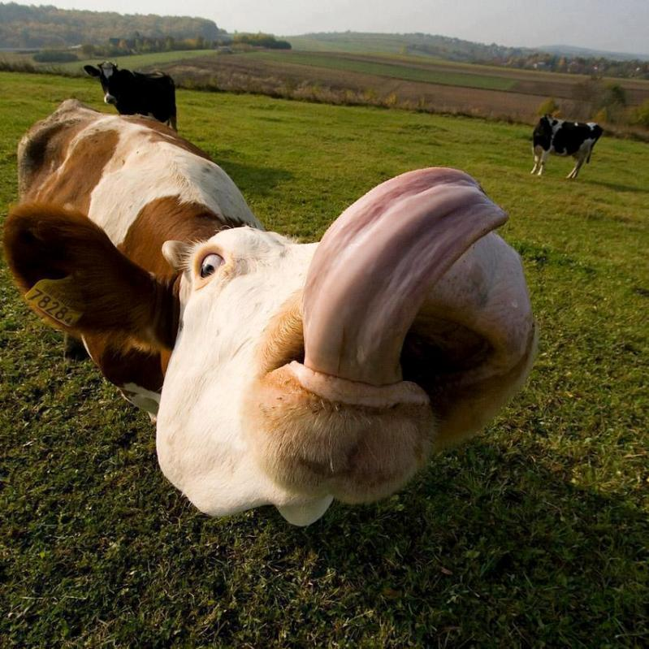
http://www.reedyforkfarm.com/502/tongue-trivia-tapping-into-the-terrific-talents-of-the-cows-tongue/
Notes:
So clearly, improvements to the compiler have made it more delicious! Hopefully you’ve now had a taste of Great Cow, and how my final year project has increased its reliability. I’m happy to answer some questions now, or you can Google “Great Cow” later if you’re hungry for more!

